Slide 1
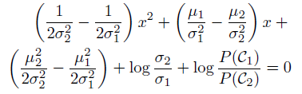
Assignment 2: Due 9/8/16
Use the equality of discriminants to derive the following quadratic equation
for decision points in a 1D, 2-class problem with Gaussian class likelihoods
Mean and standard deviation of C1 are 3 and 1, respectively
Mean and standard deviation of C2 are 2 and 0.3, respectively
Prior are equal
With a sample size of 100 for each class, compare the MLE estimators to the true means and variances.
For the same samples, compare Bayesian discriminant points calculated from
MLE estimators with those derived from the true means and variances.

